Slide 1
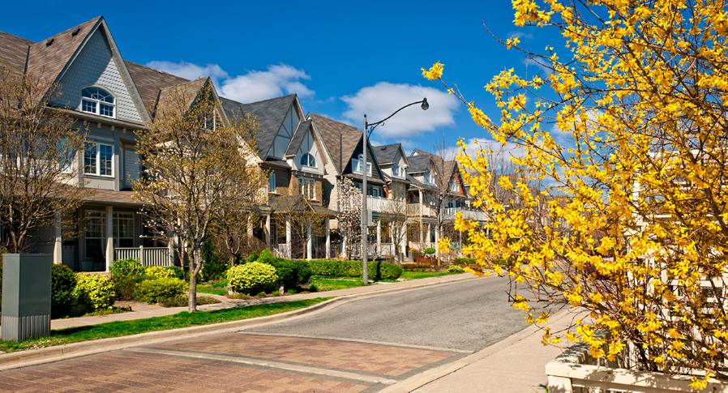
CANADA HOUSING MARKET PREDICTIVE ANALYTICS
Presented By: Nauman Khalid

Slide 2

About this Data…
The dataset comprises 30,000+ house listings across Canada (up to 2023), featuring attributes such as price, city, province, address, bedrooms, bathrooms, and median income. The objective of this exercise is to provide predictive analytics of house prices all across Canada.

Slide 3
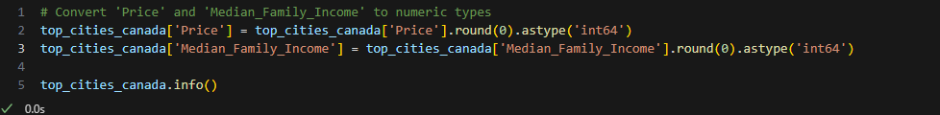
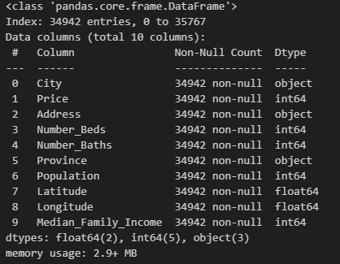
PYTHON CODE SNIPPET

Slide 4
Models
For Predictive Analysis two models were employed.
Linear Regression
Random Forest

Slide 5
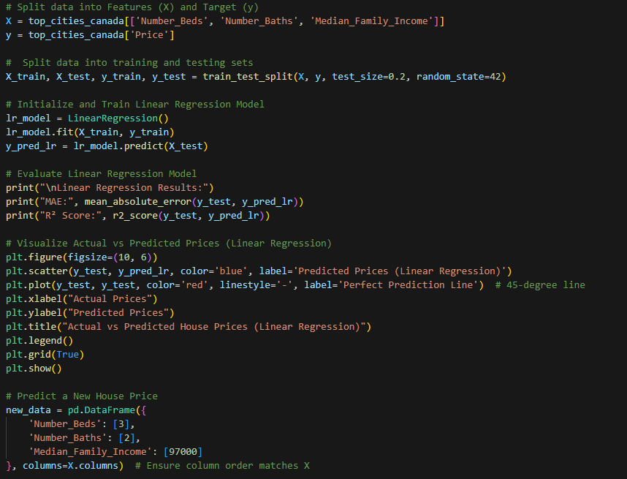
PYTHON CODE SNIPPET

Slide 6
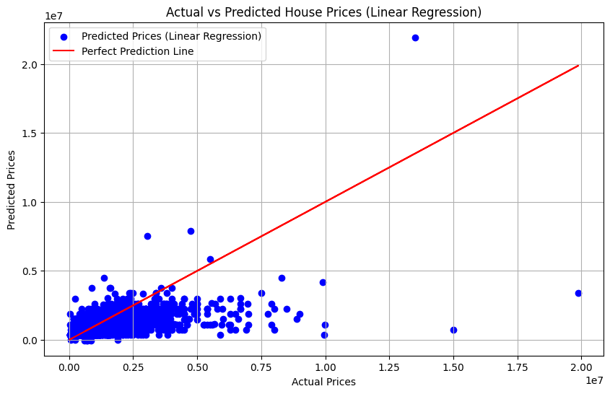
Linear Regression Model
Linear Regression Results: MAE: 451463.0711 R² Score: 0.2616
Each blue dots represent the actual predictions made by the model. These dots are deviated significantly from the red line means many predictions are inaccurate.
Red line is the "Perfect Prediction Line" (y = x), where the predicted prices would perfectly match the actual prices. Points lie on red line are perfectly predicted by the model.
Most of the data points are clustered in the lower price range (0 to ~4.8 millions).
For larger house prices (above ~ 1e7), the model underpredicts the values. The blue dots are far below the red line in this region.
A few extreme points (e.g., very high actual prices with low predictions) suggest that the model fails to account for unusual or outlier cases.
The model struggles to predict higher house prices accurately, likely due to insufficient data for high-value properties or limitations in the linear regression model.
.

Slide 7
Explanation of the Plot Results
Metrics Overview:
Mean Absolute Error (MAE): 451463. It is the average of the absolute differences between the actual values and the predicted values. It measures how far the predictions are, on average from the actual values.
This means, on average, the model's predictions deviate from the actual house prices by about 451,463 units
R² Score: 0.2616
It is (coefficient of determination) measures how well the model explains the variability in house prices.
A value of 0.26 is quite low, meaning the model only explains 26% of the variance in the actual house prices.
In simpler terms, the model does not fit the data well.
Predicted House Price for new data: 741252

Slide 8
Summary
The linear regression model does not perform well in predicting high house prices
The low R² score (0.26) indicates poor predictive accuracy.
The model's predictions are biased towards lower values and struggle with higher prices.
The high MAE suggests the model's predictions are off by a significant margin on average.
To improve the model:
Consider using more complex algorithms (e.g., decision trees, random forests, or gradient boosting).
Include more relevant features (e.g., location, square footage, number of rooms, year of built).
Normalize or transform the data to address skewness or outliers.

Slide 9
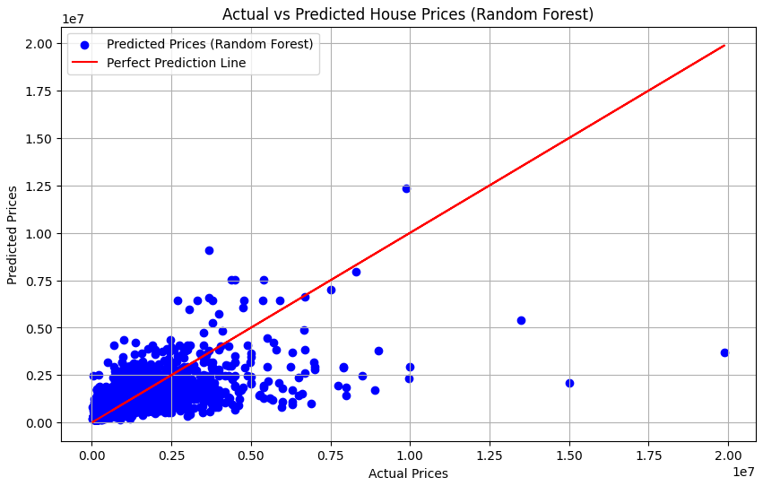
Random Forest Model
Random Forest Results: MAE: 360959.01
R² Score:0.4059
Each blue point represents a prediction made by the Random Forest model compared to the actual price.
Red line is the "Perfect Prediction Line" (y = x), where the predicted prices would perfectly match the actual prices.
Most of the data points are clustered in the lower price range (0 to ~5 millions).
Predictions appear to be close to actual values in this range, but there is still significant scatter, indicating errors.
For higher actual house prices (e.g., 10-20 million), predictions are systematically lower. This means the Random Forest model struggle to capture trends in higher price ranges, leading to underestimation.
Some predictions are far from the red line, indicating significant errors in those cases.
The model struggles to generalize for extreme values (outliers), which might be due to insufficient training data for those price ranges.

Slide 10
Explanation of the Plot Results
Metrics Overview:
Mean Absolute Error (MAE): 360,959
It is the average of the absolute differences between the actual values and the predicted values. It measures how far the
predictions are, on average from the actual values.
This means on average the model's predictions deviate from the actual house prices by about 360,959 units.
R² Score: 0.4059
It is (coefficient of determination) measures how well the model explains the variability in house prices.
0.4059 means the model explains only 40.59% of the variance in the target variable (Price), which suggests a moderate fit.
Predicted House Price for new data: 961697

Slide 11
Summary
Strengths: The model performs reasonably well for the lower price range where data is abundant.
Weaknesses: The model underestimates high-priced houses. The R² score (0.41) suggests that the model is not fully capturing
the relationship between features and prices.
Reasons for Weakness:
Lack of high-quality features (e.g., house location, size, amenities).
Insufficient representation of higher-priced houses in the dataset.
How to Improve:
Add more features like house size (square footage), age of the house, neighborhood ratings, or amenities.
Consider interactions between features (e.g., Number_Beds × Median_Family_Income).
Handle Outliers

